Slide 1
With Pretension

Slide 2
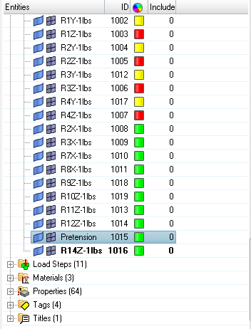
Open HyperMesh and prepare your model.
The name of the Pretension load collector has to be “Pretension”.
Make sure that spaces are removed from the names of all the entities.

Slide 3
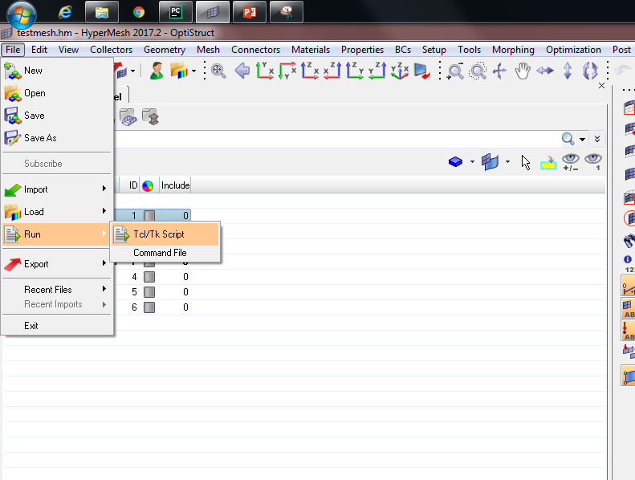
Go to File -> Run -> Tcl/Tk Script to run a script to pull the entity information from HyperMesh.

Slide 4
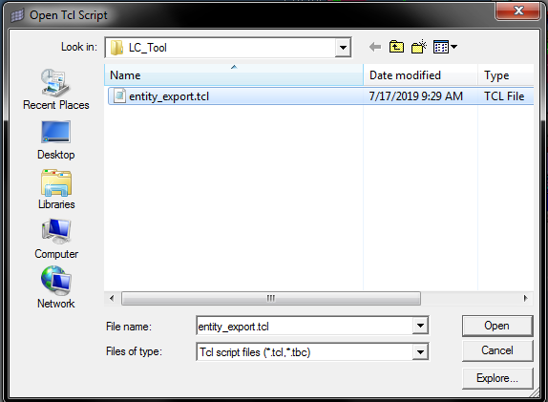
Select the entity_export.tcl file and run it.

Slide 5
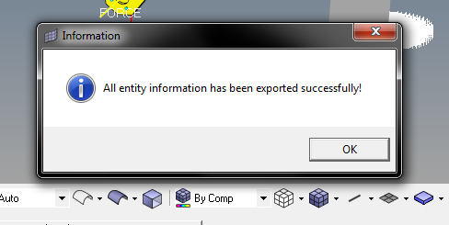
On successful execution of this script, a pop-up window will appear stating that the operation was successful.

Slide 6
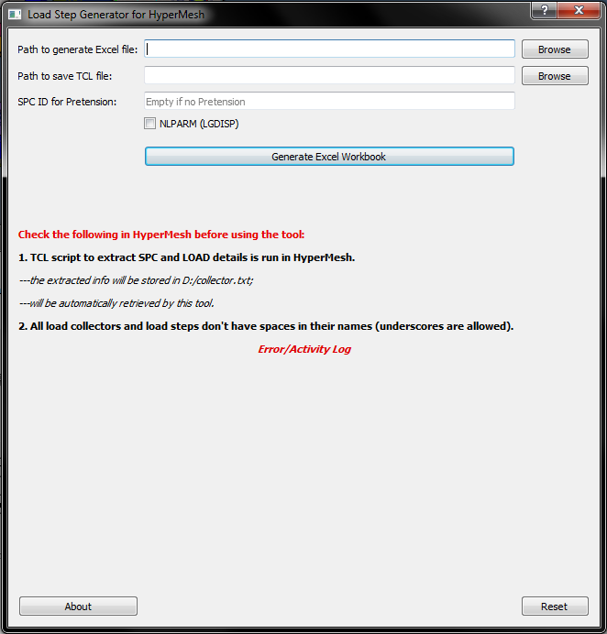
Start the tool by executing the enclosed .exe file.

Slide 7
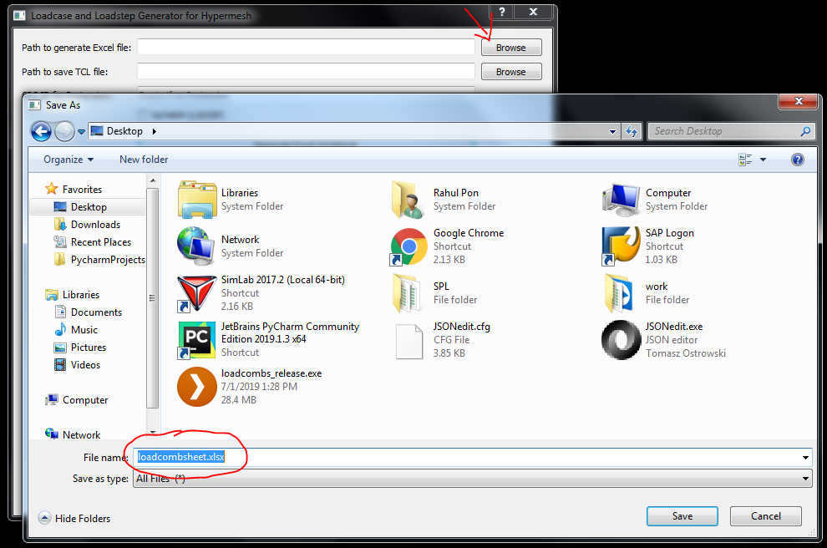
Fill the first text box with the path where the excel file has to be generated.
You can enter the path manually or use the ‘Browse’ button near the textbox.

Slide 8
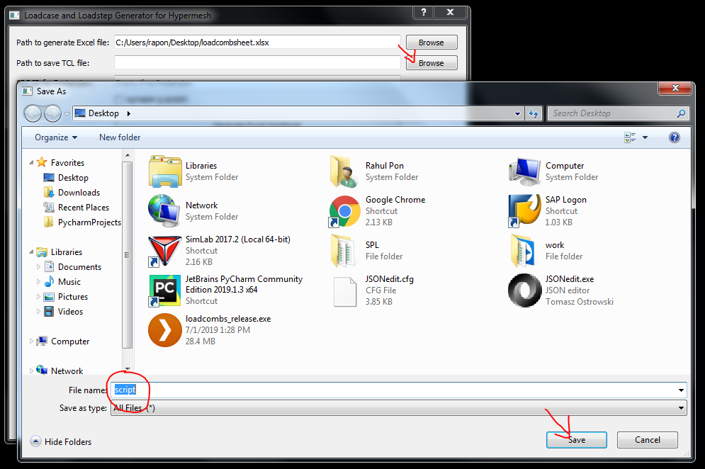
Fill the second text box with the path where the TCL file has to be saved.
You can enter the path manually or use the ‘Browse’ button near the textbox.

Slide 9
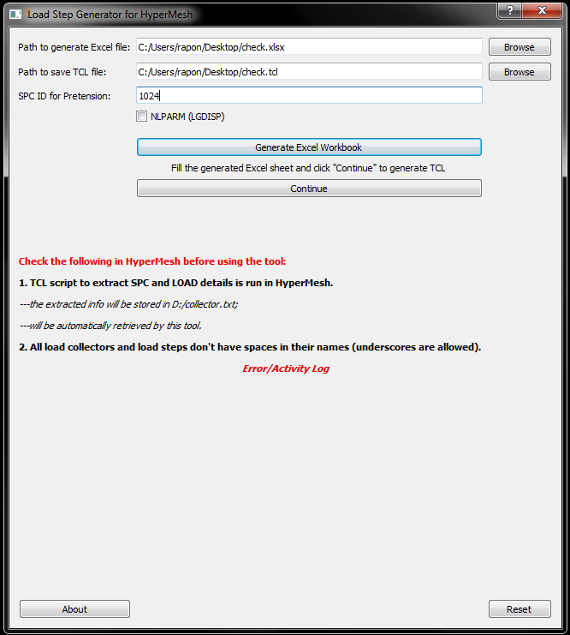
Fill in the SPC ID for the Pretension in this text box.
This will be used to create the Pretension load step card.

Slide 10
If NLPARM (LGDISP) is needed for non-linear analysis, tick this check box.

Slide 11
Click on the “Generate Excel Workbook” button to generate the Excel sheets at the specified path.

Slide 12
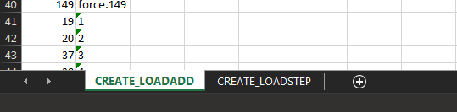
The generated workbook has two sheets.
The first one is used to generate LOADADD cards.
The second one is used to generate LOADSTEPS

Slide 13
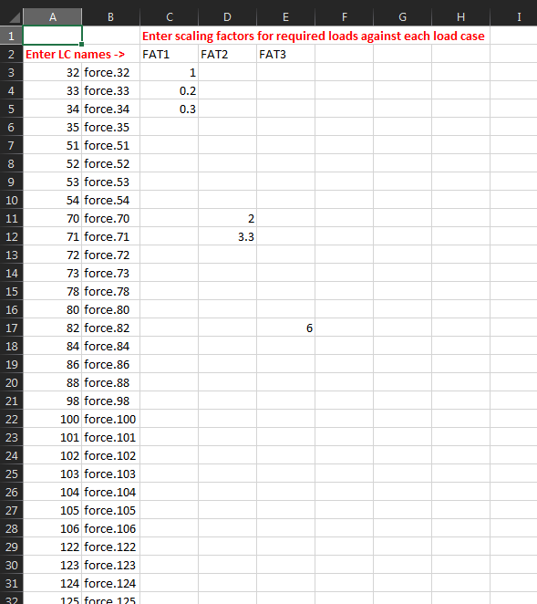
Fill the name
of the new LOADADDs
Names and IDs of loads
Auto-filled from
exported entity information
Fill the scaling factor
for each load collector
Note: Do not fill anything along the row containing the Pretension information (last row).

Slide 14
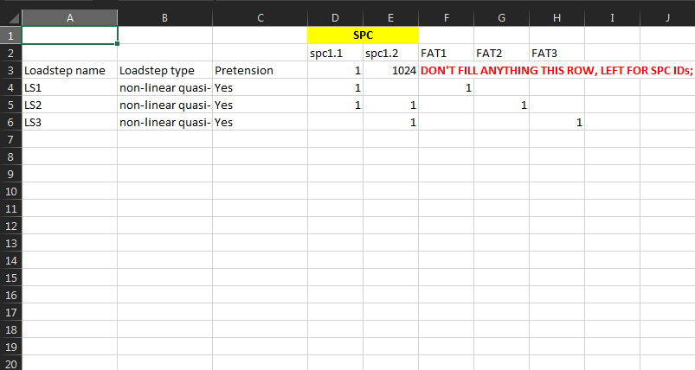
Auto-filled from the
LOADADD sheet
Select the type of analysis and pretension from the drop-down menu
Input 1 to select a
load collector
Fill the name
of the load steps
Note: The 1s input in the selection are binary; it doesn’t imply scaling factors.

Slide 15
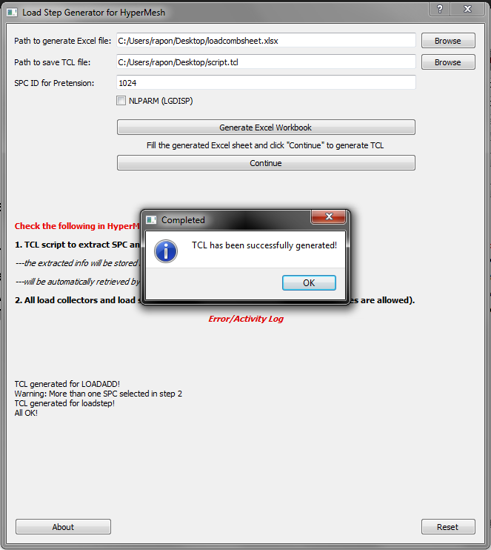
After filling the Excel sheets with the required data, save the workbook and click on the Continue button in the tool.
On successful execution of the program, a pop-up window stating the successful generation of TCL script will appear.

Slide 16
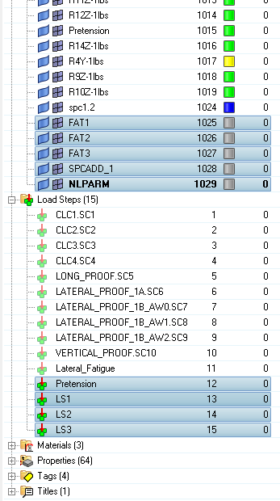
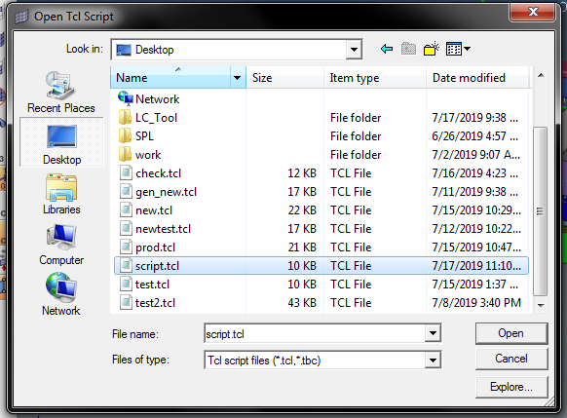
Run the generated TCL script in HyperMesh.
LOADADD cards and load steps will be created automatically in HyperMesh.
The Pretension load step card will also be generated before generating the other load steps.
NLPARM card will also be generated; it will be linked to non-linear load steps, if any.
The created entities are highlighted.
Note: New NLPARM card will not be created if NLPARM is already present in the model with the same name.

